Slide 1


Department of BES-I
COURSE: Data Structures
COURSE CODE: 24SC1204
Topic:
Name of the topic:
Singly Linked List
Session – 10

Slide 2



AIM OF THE SESSION
To familiarize students with the basic concept of Singly linked list
INSTRUCTIONAL OBJECTIVES
This Session is designed to:
Demonstrate The Singly linked list
Describe the types of Singly linked list.
List out the operations possible on the Singly linked list.
Describe each operation
List out the advantages and applications of SLL.
LEARNING OUTCOMES
At the end of this session, you should be able to:
Define Singly linked list
Describe two types of Singly linked list. And their operations
Summarize definition, types and operations of singly linked list and its applications

Slide 3
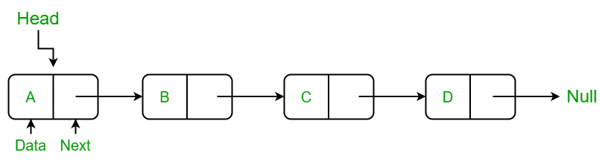
Singly Linked List
INTRODUCTION
A singly linked list is a linear data structure in which the elements are not stored in contiguous memory locations.
Each element is connected only to its next element using a pointer.
In single linked list, every node points to its next node in the sequence and the last node points NULL.

Slide 4
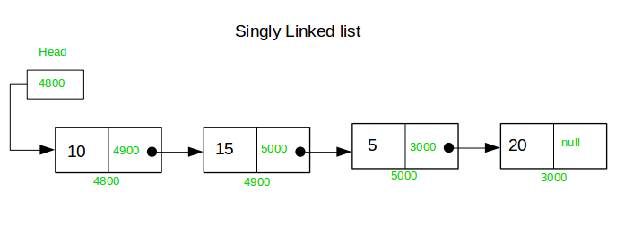
Example of Singly Linked list with 4 nodes

Slide 5
OPERATIONS ON SINGLY LINKED LIST
In a singly linked list, we can perform the following operations...
  Search
  Counting
  Traversing
  a) forward direction
  b) reverse direction

Slide 6
Setup the Singly Linked List
Before we implement those operations, first we need to setup empty list.
Perform the following steps to setup Empty SLL:.
Step 1 - Define a Node structure with two members/fields data and next
Step 2 - Define a Node pointer 'head' and set it to NULL.
Step 3 – Then perform the Operations one by one.
The node is defined (represented) as:
struct Node
{
int data;
struct Node * next;
};
struct Node *head=NULL;

Slide 7
1) Search Operation in Singly Linked List
In searching, we match each element of the list with the given element.
If the element is found on any of the location, then location of that element is returned otherwise null is returned.

Slide 8
Algorithm:
Step 1: SET PTR = HEAD
Step 2: Set I = 0
STEP 3: IF PTR = NULL
WRITE "EMPTY LIST"
GOTO STEP 8
END OF IF
STEP 4: REPEAT STEP 5 TO 7 UNTIL PTR != NULL
STEP 5: if ptr → data = item
write i+1
End of IF
STEP 6: I = I + 1
STEP 7: PTR = PTR → NEXT
[END OF LOOP]
STEP 8: EXIT

Slide 9
2)Traversing Operation in Singly Linked List
In traversing, we simply visit each node of the list at least once in order to perform some specific operation on it, for example, printing data part of each node present in the list. We traverse in the forward direction i.e starting from the head.
Algorithm:
STEP 1: STEP 1: SET PTR = HEAD
STEP 2: IF PTR = NULL
WRITE "EMPTY LIST"
GOTO STEP 7
END OF IF
STEP 4: REPEAT STEP 5 AND 6 UNTIL PTR != NULL
STEP 5: PRINT PTR→ DATA
STEP 6: PTR = PTR → NEXT
[END OF LOOP]
STEP 7: EXIT

Slide 10
2)Traversing in reverse direction in Singly Linked List
Step 1: Create three-pointers, say, prev, current and next.
Step 2: 2.1 Initailly prev and next will point to NULL
2.2 The current will point to the head of the list.
Step 3: Begin the traversal of the list until the current is not NULL.
  3.1 For every current node during list traversal
  3.1.1 store the next of current in next
  3.1.2 then make the next of current point to prev.
  3.1.3 make prev equal to current and current equal to next.
Step 4: after the traversal is over, make the node to which prev
is pointing as our new linked list head.
By performing the above operations, we are changing the links of every node and ultimately reversing the list.

Slide 11
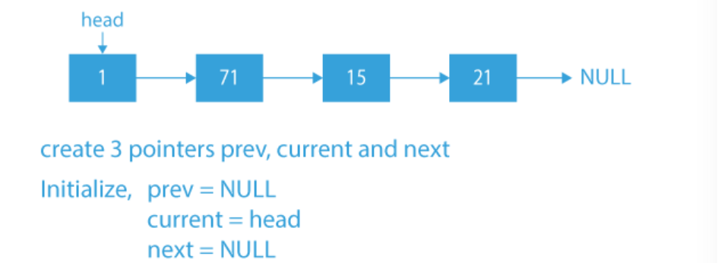
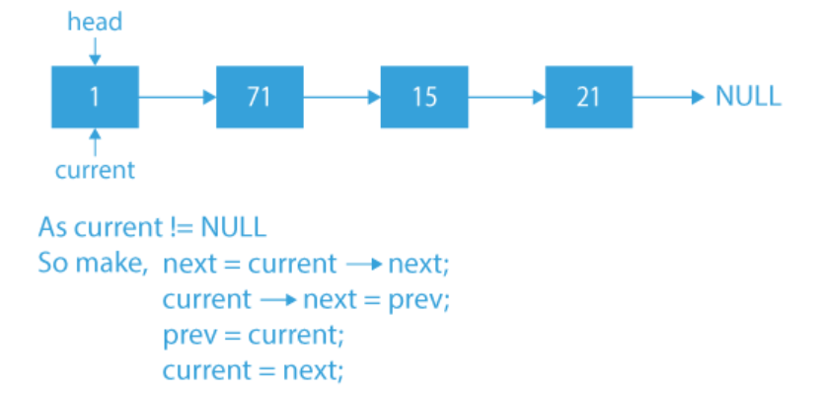
2)Traversing in reverse direction in Singly Linked List

Slide 12
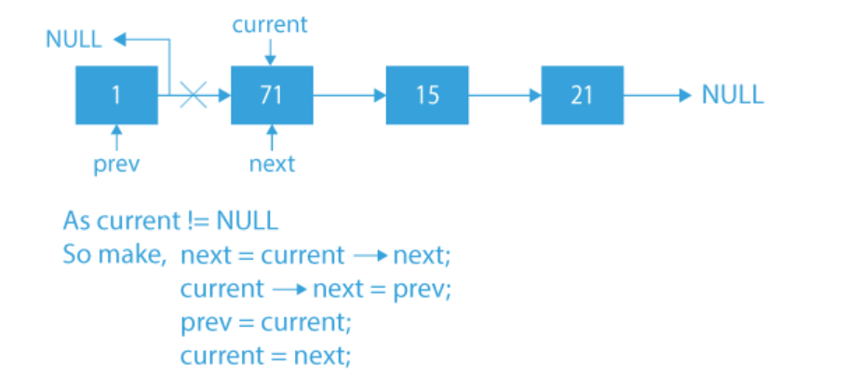
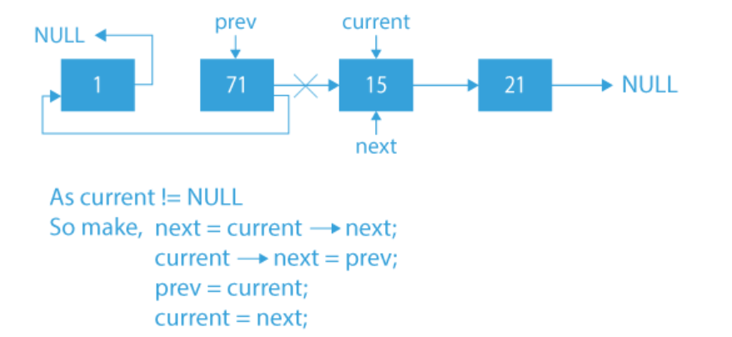
2)Traversing in reverse direction in Singly Linked List

Slide 13
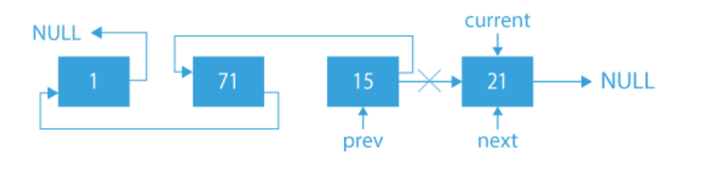
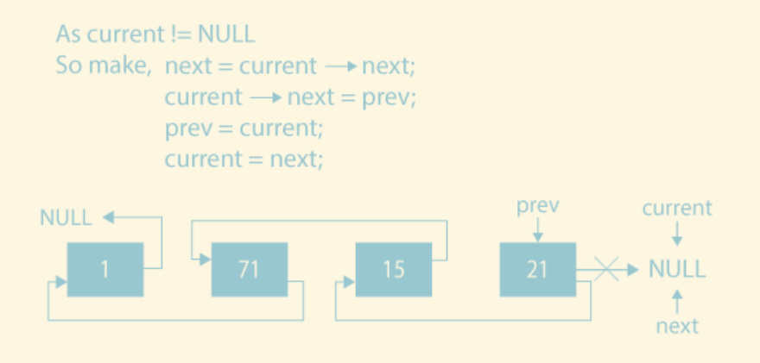
2)Traversing in reverse direction in Singly Linked List

Slide 14
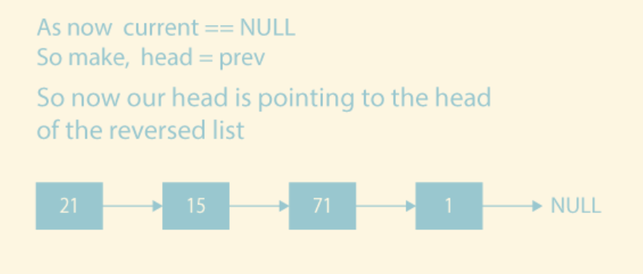
2)Traversing in reverse direction in Singly Linked List

Slide 15
3) Count Operation in Singly Linked List
Algorithm:
Step 1: Create a class Node which has two attributes: data and next. Next is a pointer to the next node in the list.
Step 2: Create another class which has two attributes: head and tail.
Step 3: addNode() will add a new node to the list:
  Create a new node.
  It first checks, whether the head is equal to null which means the list is empty.
  If the list is empty, both head and tail will point to the newly added node.
  If the list is not empty, the new node will be added to end of the list such that tail's next will point to a newly added node. This new node will become the new tail of the list.
Step 4: countNodes() will count the nodes present in the list:
  Define a node current which will initially point to the head of the list.
  Declare and initialize a variable count to 0.
  Traverse through the list till current point to null.
  Increment the value of count by 1 for each node encountered in the list.

Slide 16
THANK YOU
Team – Data Structures

